Slide 1
Code Club 4
Hypothesis testing in R
t-Tests and ANOVA

Slide 2
Why Do We Need Hypothesis Testing?
Population
(unknown)
We observe differences in data all the time — but are they real or just random noise?
Examples:
Does this batch of tablets contain 200mg of ibuprofen?
Does this drug lower blood pressure?
Does formulation type affect dissolution?
Goal: make principled decisions from samples, when measuring the whole population is not feasible
Sampling
Inference
Sample
(what we measure)

Slide 3
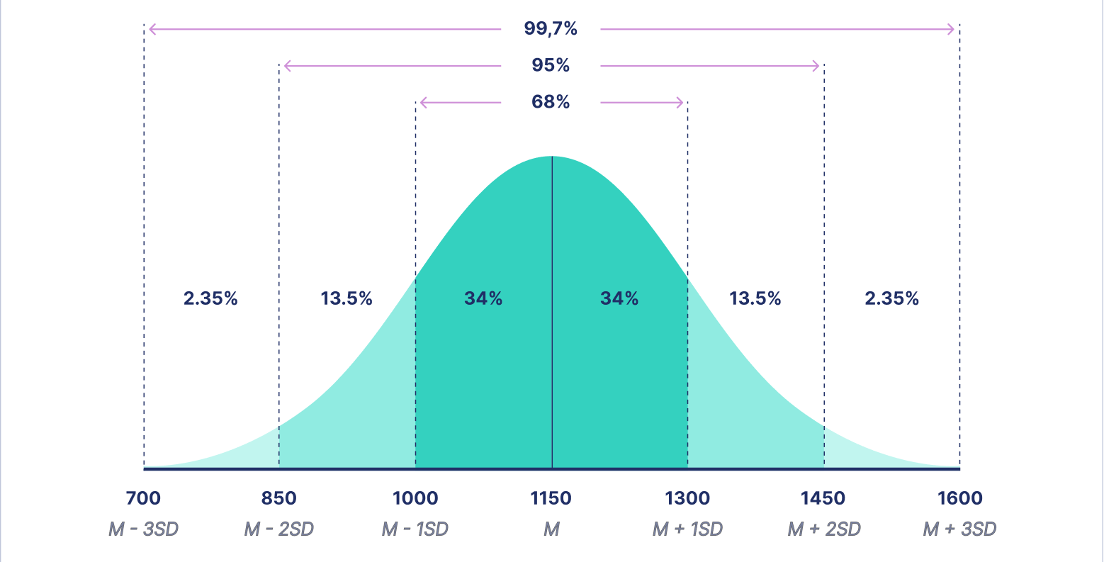
The Normal Distribution

Slide 4
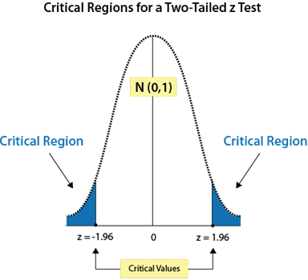
The Null Hypothesis and P-value
H₀: the boring default — nothing is happening (no difference, no effect)
We ask: how surprising is our data if H₀ were true?
The p-value is the probability of observing data at least this extreme, assuming H₀ is true
We use α = 0.05 as our threshold — a 5% chance of a false positive
p-value is NOT the probability that H₀ is true, and NOT the probability your result is due to chance

Slide 5
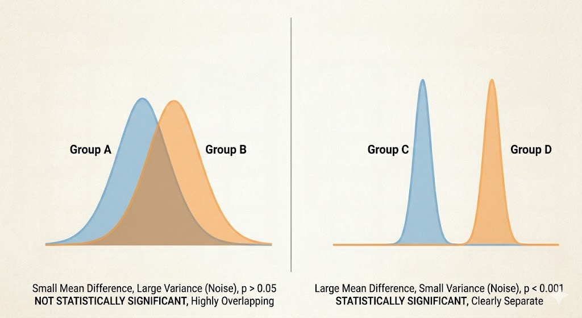
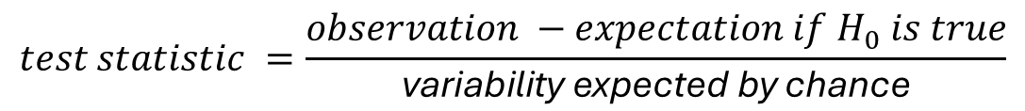
The test statistic: one formula to rule them all
All hypothesis tests share the same logic:
Large test statistic → observed difference is large relative to noise → small p-value
Different tests (t, F, χ²) are just different versions of this same idea
$$test statistic =\frac{observation −expectation if H_{0} is true}{\text{variability} \text{expected} \text{by} \text{chance}}$$

Slide 6
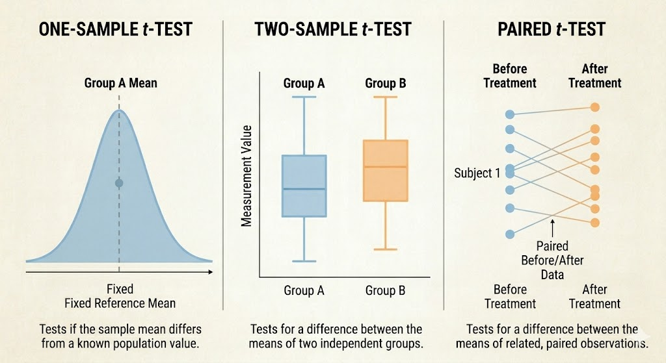
The t-test
Used for comparing means
One-sample: is our sample mean different from a target? (e.g. do tablets contain 200mg?)
Two-sample: are the means of two independent groups different? (e.g. drug vs. placebo)
Paired: same subjects measured twice — removes between-subject noise (e.g. blood pressure before and after treatment)
Key output: t-statistic, degrees of freedom, p-value, 95% confidence interval

Slide 7
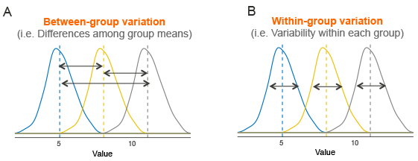
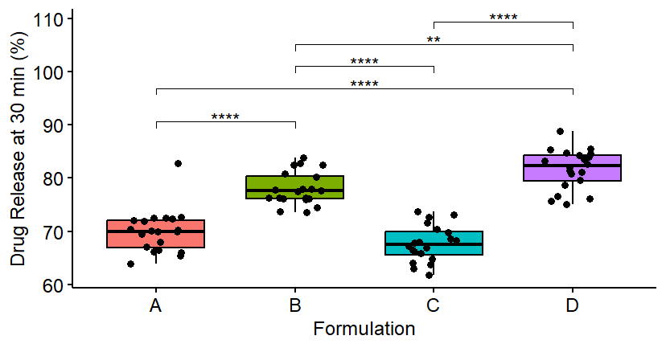
ANOVA
Used when comparing means across more than 2 groups
One-way ANOVA: one grouping variable (e.g. four formulations)
Two-way ANOVA: two grouping variables, and their interaction (e.g. formulation × dissolution medium)
The interaction term is often the most interesting — does the effect of one variable depend on the other?
ANOVA tells you something differs — post-hoc tests (Tukey's HSD) tell you which groups
Notes:
Tukey’s Honestly Significant Difference (HSD)
We need to adjust for multiple comparisons – with alpha = 0.05 (5% false positive rate) our chances increase with the number of pairs. 4 groups -> 6 pairs -> increasing the chance from 5% -> 26.5%

